Slide 1
A Minor Project Defence
On
“Earthquake Detection and Alert System ”
Presented By:
Alija Bhujel[WRC077BEI002]
Anisha Kharel[WRC077BEI004]
Ashim Shrestha [WRC077BEI007]
Pragati Basnet [WRC077BEI029]

Slide 2
Outline
Introduction
Problem Statement
Objectives
Literature Review
Requirement Analysis
Methodology
Results
Future Enhancements
References

Slide 3
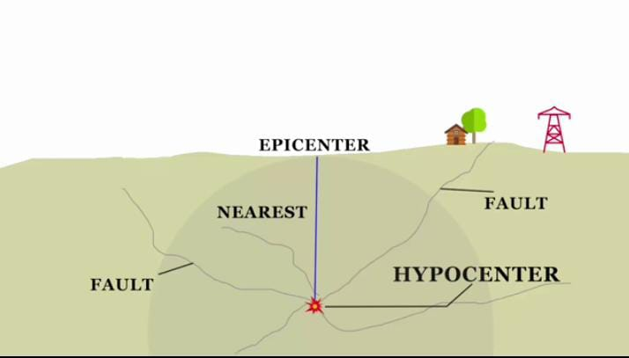
Introduction
Earthquakes result from the constant friction and movement between tectonic plates.
The breaking point, known as the hypocenter, generates seismic waves that travel to the surface through the epicenter.
Figure 1: Demonstration of epicenter and hypocenter

Slide 4
Introduction
Detecting Earthquake
Seismic waves are the key to detecting earthquakes.
Two types of seismic waves: P-waves and S-waves.
Types of seismic waves
P-waves: Travel faster at 5 m/s, move linearly, and are not the primary cause for concern.
S-waves: Slower at 3.5 m/s, travel in a sideways and vertical pattern, causing disruption by displacing rocks.

Slide 5
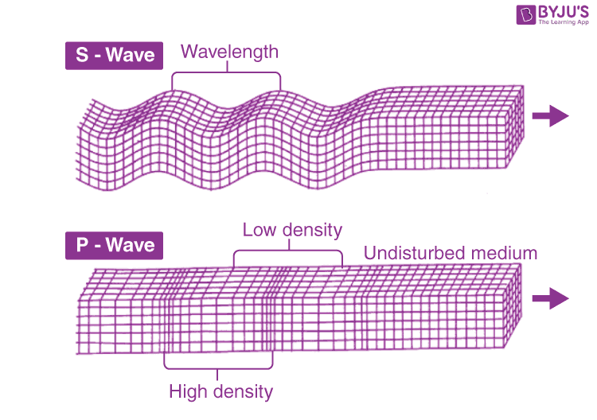
Figure 2: Pictorial demonstration of s and p waves

Slide 6
Introduction
Utilizing wave properties
We focus on detecting P-waves to prevent the subsequent disruptive effects of S-waves in our project.
Leveraging the difference in wave speeds and directional patterns to aid in earthquake detection.

Slide 7
Introduction
 | Primary Wave (P) | Secondary Wave (S)
Solid Rock | 6 - 8 | 3.5 - 4.5
Loose Soil | 1.8 - 3.0 | 1.0 - 1.5
Water | ~1.5 | Not
Concrete | 3.5 - 5.0 | 2.0 - 3.0
Sand | 1.0 - 2.0 | 0.5 - 1.0
Steel | 5.0 - 6.0 | 3.0 - 4.0

Slide 8
Introduction
Innovative and applicability
Overcome challenges in resource-constrained environments.
Democratize earthquake monitoring.
Enhance system applicability for diverse technological infrastructures.

Slide 9
Problem Statement
The current system may generate false alarms, leading to unnecessary public panic and eroding public trust.
The existing system may not cover all areas, leading to missed detections and potential risks in remote areas.
There may be communication failures, potentially hindering the delivery of critical alerts.
Ongoing maintenance challenges can compromise the reliability of earthquake data.

Slide 10
Objectives
To create a user-friendly interface for easy access to earthquake data.
To enhance the accuracy and reliability of seismic data to minimize false alarms.
To implement an effective warning system that provides timely alerts.
To establish a real-time monitoring system for continuous monitoring and alerting.

Slide 11
Literature Review
Paper Title | Authors | Components Used | Key Findings
Wireless earthquake alarm system using ATmega328p, ADXL335 and Xbee S2 | S. Katila, J. N. Borole, & K. Rane | ATmega328p,ADXL335 XBeeS2 | Detection of earthquake shock by monitoring the X, Y, and Z axes of the ADXL335 accelerometer
Earthquake Alarm System Based on Advanced Wireless GSM Modem | Prof. P. Khatwa, G. Ingle, & R. Shinde | Microcontroller, GSM modems | Enhanced with GSM modems for mobile communication

Slide 12
Paper Title | Authors | Components Used | Key Findings
Automatic pothole and speed breaker detection using android system | V. Rishiwal and H. Khan | Built-in accelerometer of an android device | Android device placed on a flat horizontal surface for data collection
Wireless Monitoring of a Structural Beam to be Used for Post-Earthquake Damage Assessment | B. Ozbey, O. Kurc, H.V.Demir, V. B. Erturk & A. Altintas | Passive Nested Split-Ring Resonator (NSRR) Probes,rebars ,antenna | Detection of plastic deformation strain/displacement in the beam
An emergency earthquake warning system using mobile terminals with a built-in accelerometer | T. Uga, T. Nagaosa & D. Kawashima | Server,mobile-based seismometer | Acknowledgment of challenges related to false alarms and limited sensor coverage

Slide 13
Requirement Analysis
Hardware Requirements
GSM Module : Communication system for notify
ADXL335 accelerometer :reads acceleration as analog voltage
Arduino Nano: Microcontroller which reads sensor data
Node MCU : communicate with backend server.
LCD Display: Visual interface and sensor readings.
Buzzers : Alert users through alarms.

Slide 14
Software Requirements
React.js: develop user interface and give visual data in frontend.
Node.js : For Backend.
Arduino IDE : Software application designed specifically for programming Arduino boards.
VS Code: Visual Studio Code, often abbreviated as VS Code, is a popular source-code editor developed by Microsoft for Windows,Linux, and macOS.

Slide 15
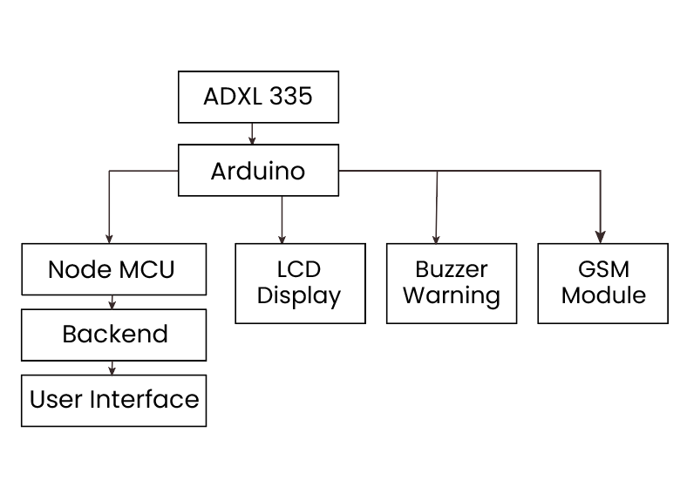
Methodology
Figure 3: System Architecture

Slide 16
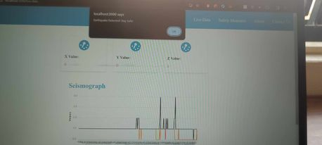
Results
User interface of our software

Slide 17
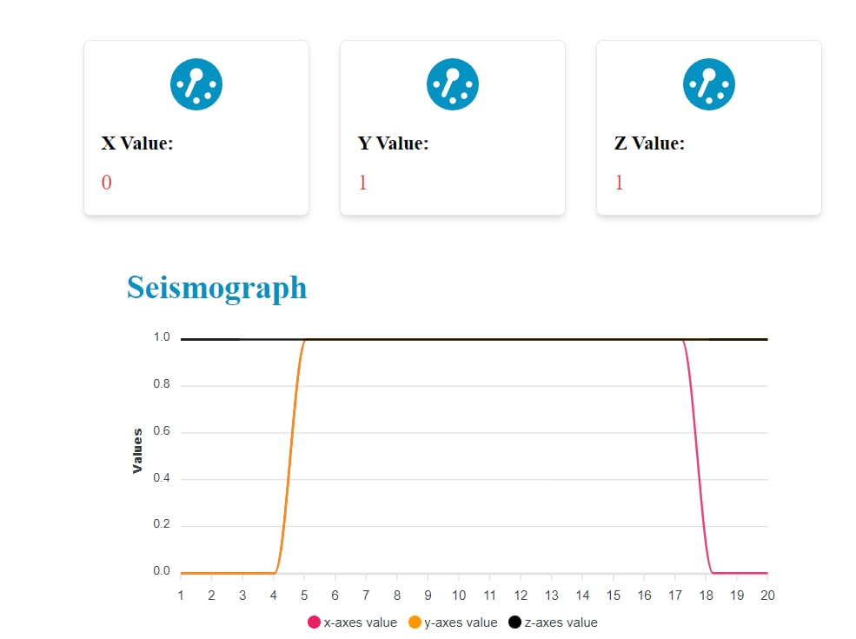
Results
User interface of our software

Slide 18
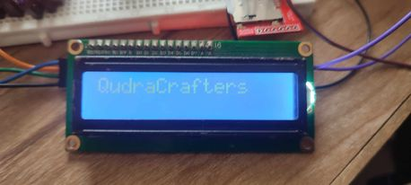
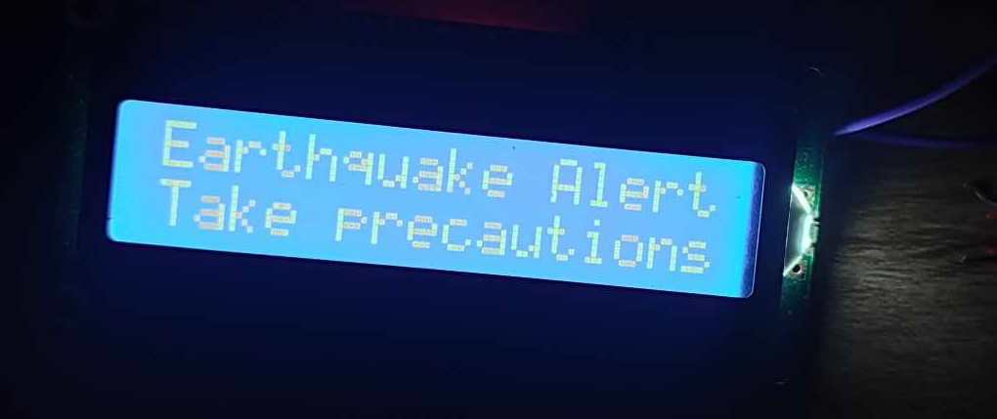
Results
LCD display result

Slide 19
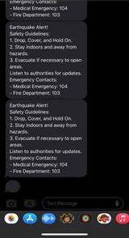
Results
Alert message through GSM module

Slide 20
Future Enhancements
Integrate machine learning algorithms for enhanced data analysis and predictive capabilities.
Implement cloud-based data storage for simplified access and analysis.
Collaborate with research institutions for valuable insights and advancements.
Develop algorithms to provide precise date, time, and magnitude of earthquakes for effective response.

Slide 21

Results

Slide 22

Results

Slide 23
References
[1] Sanjib Kalita, J.N Borole and Dr. K.P Rane (June 2014) “Wireless earthquake alarm system using Atmega328p ADXL335 and XBee S2.”
[2] Prof. Pradeep Khatwa, Gaurav Ingle, Rameshwar Shinde, Ajay Sane (Feb 2018) “Earthquake alarm system based on advanced wireless GSM modem.”
[3] Wenxiang Jiang, Haiying Yu, Lei Huang (March 2015) “A Robust Algorithm for Earthquake Detector”

Slide 24
[4] Burak Ozbey, Ozgur Kurc, Hilmi Volkan Demir, Vakur B. Erturk, and Ayhan Altintas (August 2017) “Wireless Monitoring of a Structural Beam for Post-Earthquake Damage Assessment”
[5] T. Nagaosa, Daichi, T. Uga, “An emergency earthquake warning system using Mobile Terminals with a built-in accelerometer, 12th International conference on ITS Telecommunication.”

Slide 25
THANK YOU

